Slide 1
Computer Vision
FALL 2020
Problem Set #4
Parin Patel
ppatel480@gatech.edu
Computer Vision @ GT

Slide 2

1a: Base Shift0 and ShiftR2
ps4-1-a-1
Computer Vision @ GT

Slide 3
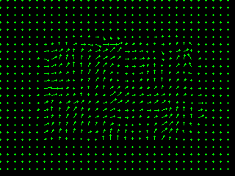
1a: Base Shift0 and ShiftR5U5
ps4-1-a-2
Computer Vision @ GT

Slide 4
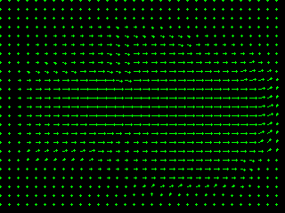
1b: Base Shift0 and ShiftR10
ps4-1-b-1
Computer Vision @ GT

Slide 5
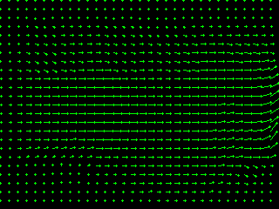
1b: Base Shift0 and ShiftR20
ps4-1-b-2
Computer Vision @ GT

Slide 6
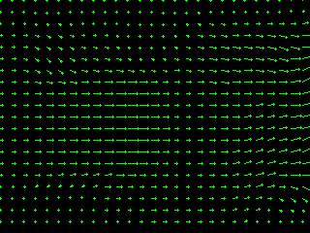
1b: Base Shift0 and ShiftR40
ps4-1-b-3
Computer Vision @ GT

Slide 7
1b: Text Response
Does LK still work? Does it fall apart on any of the pairs? Try using different parameters to get results closer to the ones above. Describe your results and what you tried.
LK falls apart with larger movements. Using Gaussian kernels with larger ksize helped a little as the blurring effectively reduces the large pixel movements, but it did not work very well. Increasing ksize with uniform or Gaussian kernels helped a little, but LK still fell apart. For different sigma with Gaussian kernels, LK did not work very well with very large or very small sigmas and tuning that was very difficult and still not that effective.
Computer Vision @ GT

Slide 8
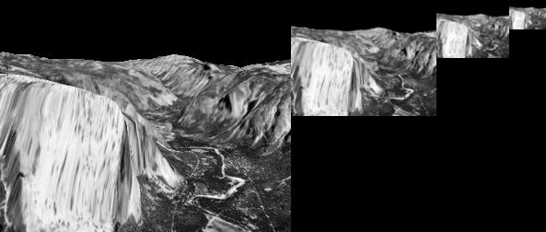
2a: Gaussian Pyramid
ps4-2-a-1
Computer Vision @ GT

Slide 9
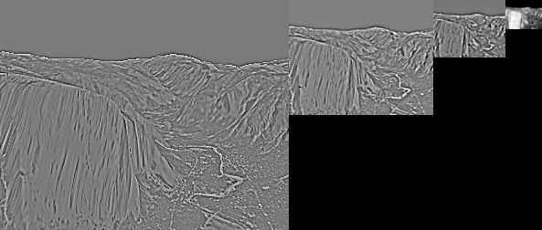
2b: Laplacian Pyramid
ps4-2-b-1
Computer Vision @ GT

Slide 10
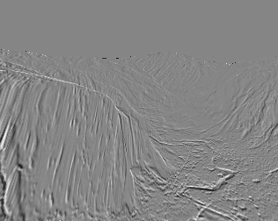
3a: Difference images
ps4-3-a-1
Computer Vision @ GT

Slide 11
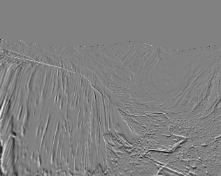
3a: Difference images (cont.)
ps4-3-a-2
Computer Vision @ GT

Slide 12

4a: Hierarchical LK
ps4-4-a-1
Computer Vision @ GT

Slide 13
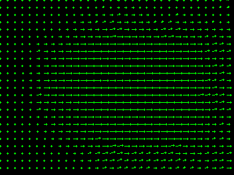
4a: Hierarchical LK (cont.)
ps4-4-a-2
Computer Vision @ GT

Slide 14
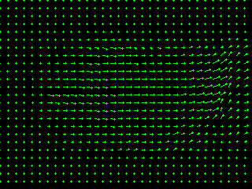
4a: Hierarchical LK (cont.)
ps4-4-a-3
Computer Vision @ GT

Slide 15

4b: Hierarchical LK (cont.)
ps4-4-b-1
Computer Vision @ GT

Slide 16
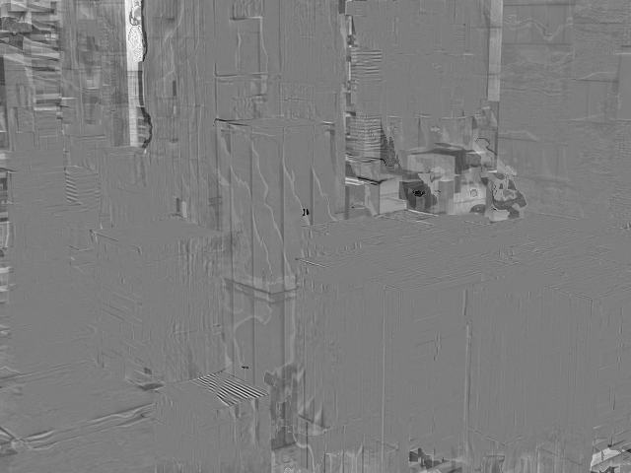
4b: Hierarchical LK (cont.)
ps4-4-b-2
Computer Vision @ GT

Slide 17
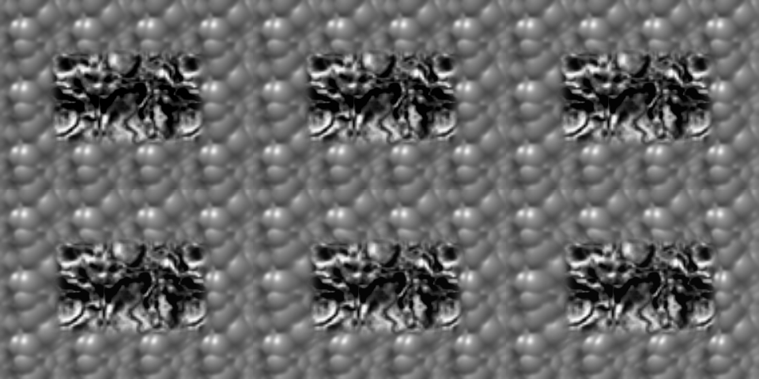
5a: Frame Interpolation
ps4-5-a-1
Computer Vision @ GT

Slide 18
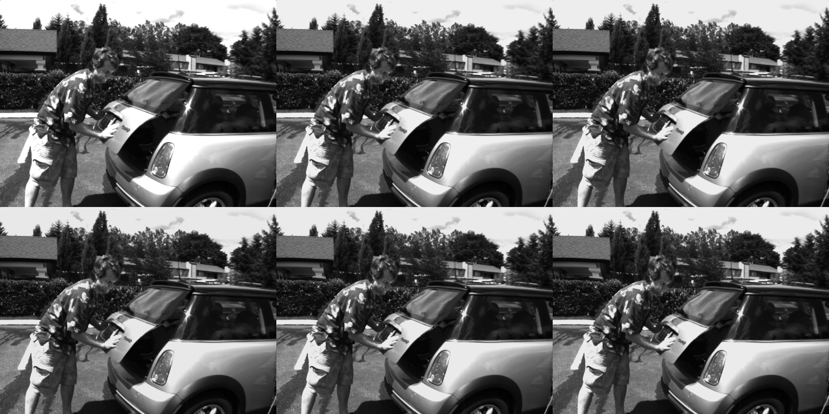
5b: Frame Interpolation
ps4-5-b-1
Computer Vision @ GT

Slide 19
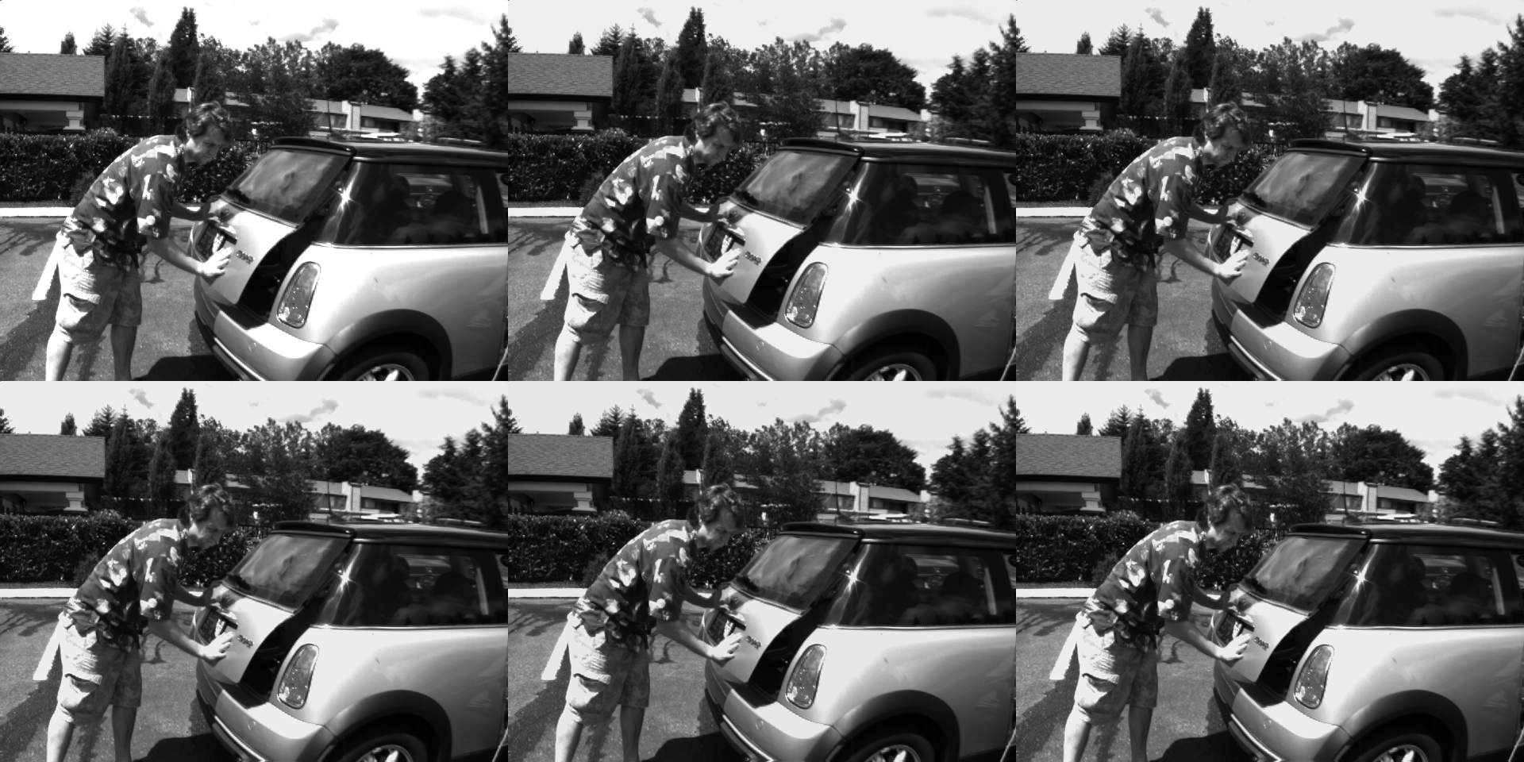
5b: Frame Interpolation
ps4-5-b-2
Computer Vision @ GT

Slide 20

6: Challenge Problem
ps4-6-a-1
Computer Vision @ GT

Slide 21

6: Challenge Problem (cont.)
ps4-6-a-2
Computer Vision @ GT

Slide 22
6: Challenge Problem (cont.)
Video link:
https://gtvault-my.sharepoint.com/:v:/g/personal/ppatel480_gatech_edu/EWkmkRSAQ79HupxwnDHBjlQBA9ZhakXbeEKciN_-lVWfYg?e=CnmvX2
Computer Vision @ GT

Slide 23
If your pdf is larger than 7MB
Please compress it using (or something similar):
https://smallpdf.com/compress-pdf
Verify that all images are still visible for grading.

